Slide 1
NPTEL
Video Course on Machine Learning
Professor Carl Gustaf Jansson, KTH
Week 4 Inductive Learning based on
Symbolic Representations
and Weak Theories
Video 4.4 Instance Based Learning Part 2

Slide 2
Distance-Weighted Nearest Neighbor Algorithm
The k-nearest neighbor classifier can be viewed as assigning the k nearest neighbors a weight of 1 and all others a weight of 0.
This can be generalized to weighted nearest neighbor classifiers. That is, where the ith nearest neighbor is assigned a weight wi where i=1..k.
A typical weight is the inverse of the square of the distance = 1/ d(xq, xi)^2.
The weighted k-NN algorithm can be used both for classification or regression:
In weighted k-NN classification, the output is a class membership. An query instance (xq) is assigned the class label most common among its k nearest neighbors where the ´vote´ of each neighbor i is weighted with wi.
In k-NN regression, the output is the property value for the query instance (xq). This value is the weighted sum of the property values of its k nearest neighbors divided by the sum of the weights.
In the weighted approach one can extend the k-nearest neighbor method from k to all dataitems. The alternative to keep to k elements is called a local weighted method while the extension to all dataitems is called a global weighted method.

Slide 3
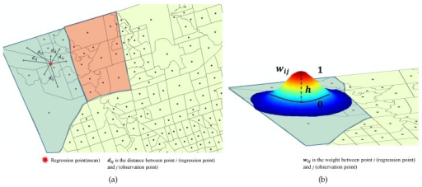
Locally Weighted Regression
The nearest neighbor approaches approximate a target function for a single query instance (xq). Locally weighted regression (LWR) is an extension of this approach. It constructs an explicit approximation of the target function over a local region surrounding xq. The approximation may be a linear function, a quadratic function etc.
The term local in term locally weighted regression is motivated by the fact that approximation is based only on data near to xq.
The term weighted is motivated by the fact that the contribition of training instances are weighted based on the distance from xq. The weights are defined by a so called kernel function.
One can say that the kernel function moderates the original distance measure.
The term regression is motivated by the fact that we aim at approximating real-valued functions.

Slide 4
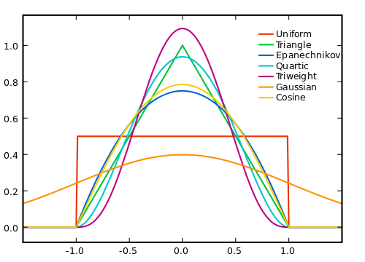
Kernel functions in
Non parametric Statistics
A Kernel is a window function. When the
Argument is a distance measure on can say that
the kernel function is a moderation of the original distance measure.
A Kernel is a non-negative real valued integrable function K.
For most applications, it is common to define the function to satisfy two additional requirements:
The infinite integral over K(x)dx = 1
K(x) = K(-x) for all x.
Several types of kernel functions are
commonly used: uniform, triangle,
Epanechnikov, quartic (bi-weight),
tri-weight, Gaussian, and cosine.

Slide 5
Kernel methods as a kind of instance-based learners
Kernel functions are also useful in a kind of weighted instance-based learners called kernel methods. The kernel function here serves as a similarity function.
This kind of method typically computes a classification as a weighted sum of similarities:
Cq =Sign (i=1..n Sum wi*ci*k(xi, xq))
where
xi and ci are the feature vector and class label (+1, -1) for the training instance i
cq is the (+1 or -1 )for the unlabeled input xq
the wi are the weights for the training examples
k is the function that measures similarity between any pair of instances = kernel
the sum ranges over the n labeled examples in the classifier's training set
the Sign function determines whether the predicted classification comes out positive or negative (+1, -1).

Slide 6
Structure for the rest of the lecture
1a. Binary Linear Classifier
Instance Based Learning
2. Kernel Methods
3. Support Vector Machine
4. The Kernel Trick
1 b. Binary Non Linear Classifier

Slide 7
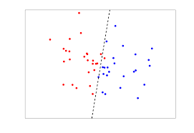
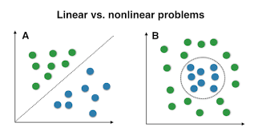
Binary Linear ( and Non Linear) Classifiers
Binary Linear Classifiers are classifiers which are both
binary (they distinguish between two categories) and
linear (the classification is based on a linear function of the inputs).
Each data item is characterized by a vector x of features i=1..n. We will refer to features of an instance x as ai(x).
Associated with each instance is a binary-valued class label: c(x).
The goal of a Binary Linear Classifier is to find a a hyperplane (line, plane...) that separates the instances of the two categories.
The property of the instance space required for such a hyper plane to be found is called linear separability. Obviously the linear classification techniques can only handle linearly separable cases.
Techniques that can handle the non-linear situations we call non linear classifier techniques.

Slide 8
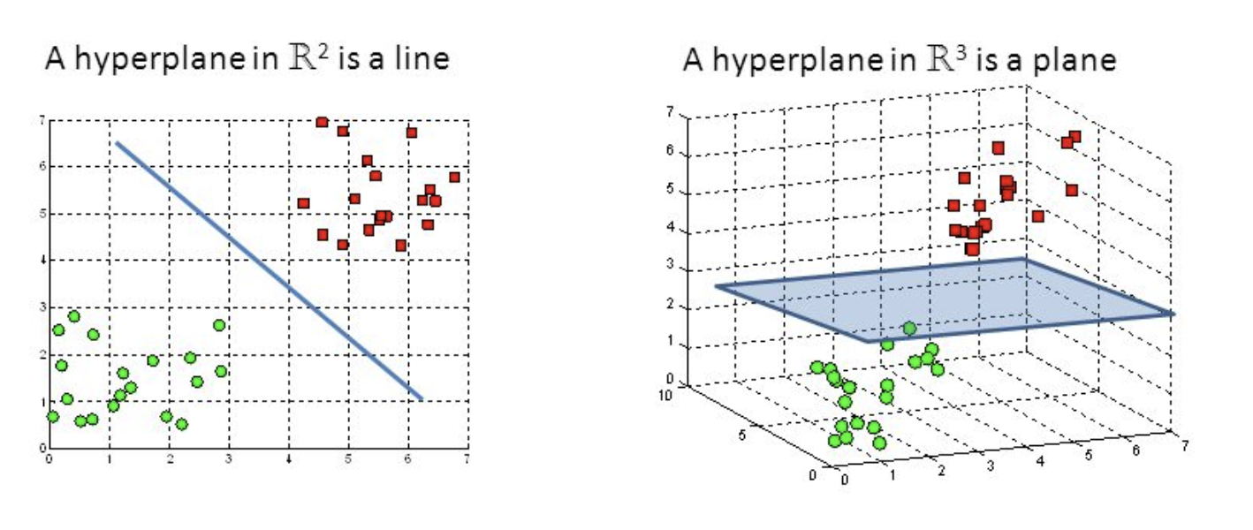
Hyperplane
A hyperplane in an n-dimensional Euclidean space is a
n-1 dimensional subset of that space that divides the space
into two disconnected parts. Examples show hyperplanes
in 2 and 3 dimensions.

Slide 9
Support Vector Machine
A Support Vector Machine is a kind of machine learning algorithm which:
Operates in a supervised mode with pre-classified examples
Can also operate in an incremental model
Is an instance of a non-probabilistic binary linear classifier system, where binary means that it classifies instances into two classes and linear means that the instance space have to be linearly separable
Can be used to handle non-linear problems if the original instance space is transformed into a linearly separable one
Manages a flexible representation of the class boundaries
Contains mechanisms to handle overfitting
Has a single global minimum which can be found in polynomial time.
It is popular because:
it is easy to use
it often has good generalization performance
the same algorithm solves a variety of problems with little tuning.

Slide 10
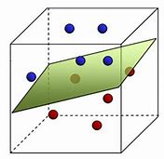
Support Vector Machine
A Support Vector Machine (SVM) performs binary linear classification by finding the optimal hyperplane that separates the two classes of instances.
A hyperplane in an n-dimensional Euclidean space is a flat, n-1 dimensional subset of that space that divides the space into two disconnected parts. In the two dimensional space a hyperplane is a line dividing the plane in two parts.
New instances are mapped into the instance space and predicted to belong to one of the classes based on which side of the hyperplane they are positioned.
Support Vector Machines can in the default case only be applied to linearly separable instance spaces.

Slide 11
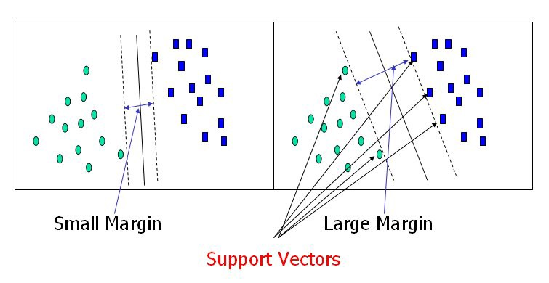
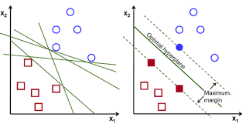
Informal outline of the Support
Vector Machine algorithm
A small subset of instances in the border line region between the main instance space regions for the two classes are chosen as corner stones for the analysis. These are called ´Support Vectors´.
The SVM algorithm aims at maximizing the margins around the separating hyperplane, i.e. maximizing distances between the target hyperplane and the chosen closest support vectors.
The optimal (maximum margin) hyperplane is fully specified by the chosen support vectors.
The optimization problem can be expressed as a Quadratic programming problem that can be solved by standard methods.

Slide 12
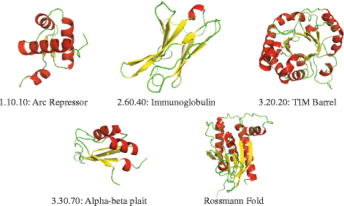
Applying a SVM to non-linear and non- feature vector data cases.
As the SVM only handles linearly separable instance spaces with instances expressed in fixed length real value feature vector form, all problems that we want to approach with SVM have to be transformed into such kind of linearly separable spaces typically of higher dimensionality than the original.
We have two important cases:
Non linearly separable spaces of feature vector instances
2. Instance spaces with the raw instances expressed in other forms
The further discussion will illustrate the first case.

Slide 13
The Kernel Trick
To most natural way to transform a non-linear feature space
to an equivalent linear space is to make the target space more
high dimensional.
However, computation of instance coordinates in the high dimensional target space is often more complex and costly.
Luckily enough, the SVM algorithm only needs a distance/similarity measure between instances positioned in a linearly separable space.
If we choose the distance/similarity function in the target space (the kernel function K) in a clever way, we can potentially express it in terms of the coordinates from the original instance space.
The clever choice is to define the kernel K in terms of the Inner Product of the mappings of the coordinates in the original space.

Slide 14
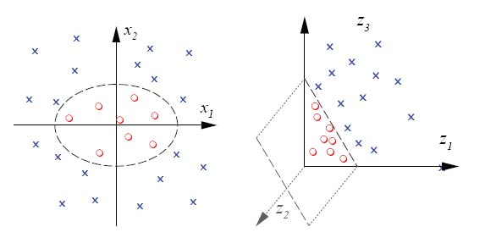
Example
Consider a two-dimensional input space and a three-dimensional
target space with the following feature mapping onto the
linearly separable three dimensional space:
X: = F : ( x1, x2 ) -> (x1^2, x2^2, sqrt 2*x1*x2)
Z: = F : ( z1, z2 ) -> (z1^2, z2^2, sqrt 2*z1*z2)
K (X,Z)= the kernal or similarity function in the three dimensional space
= the inner product of X and Z in that space : |X,Z|
= |(x1^2, x2^2, sqrt 2*x1*x2), z1^2, z2^2, sqrt 2*z1*x2)|
= x1^2*z1^2 +x2^2*z2^2+2*x1*x2*z1*z2=(x1*z1+x2*z2)^2
= the square of the inner product between the corresponding
vectors in the two dimensional space

Slide 15
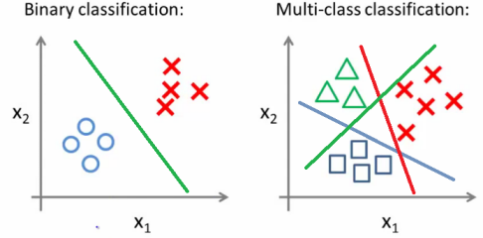
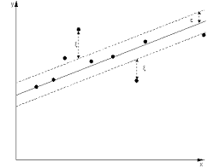
Extended use of Support Vector Machines (SVM)
As described SVM handles linear binary classification problems and by transformation of the instance space also the non-linear cases.
SVM can be modified and combined to handle multiple class problems. The strategy here is to reduce the single multiclass problem into multiple binary classification problems.
SVM can also be modified to handle regression still keeping most of the key properties of the algorithm

Slide 16
NPTEL
Video Course on Machine Learning
Professor Carl Gustaf Jansson, KTH
Thanks for your attention!
The next lecture 4.5 will be on the topic:
Cluster Analysis

